Slide 1



Slide 2
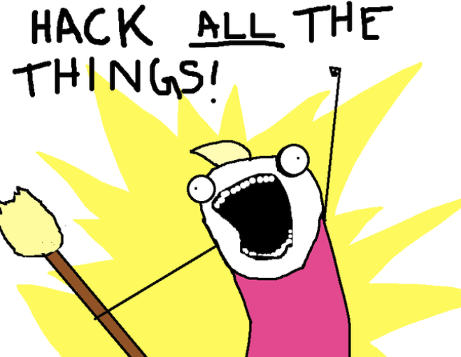
What is HAX?
School-year-long CTF for people of all skills levels
The purpose is to help students build desirable technical skills for cybersecurity through challenges
New set of challenges every ~1½ months
Each set corresponds to a topic
After new set is released, solutions for the previous set of challenges will be released and the challenges will stay live for ~1 week for students to review
Notes:
Next is topics

Slide 3
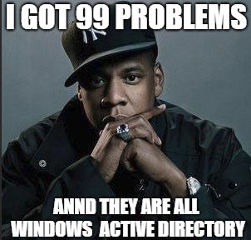
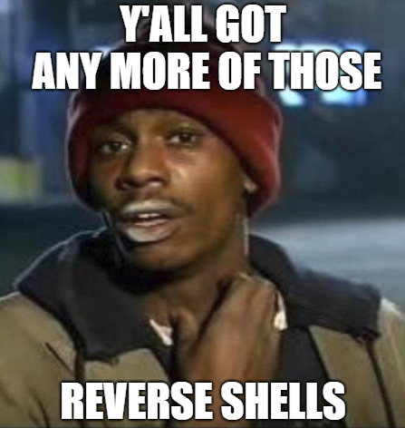
Topics Schedule
Linux/Unix (ending mid-Nov)
Bash scripting
Unix system basics and forensics
Windows
Powershell scripting
Windows basics, AD and forensics
Web/Database
OWASP Top 10
Reverse Engineering/Binary Exploitation
Stack overflows
Assembly
Cryptography
RSA
Elliptic curve cryptography
Cryptocurrencies
Network forensics
Wireshark
Bro
Scapy
Notes:
Next is prize

Slide 4
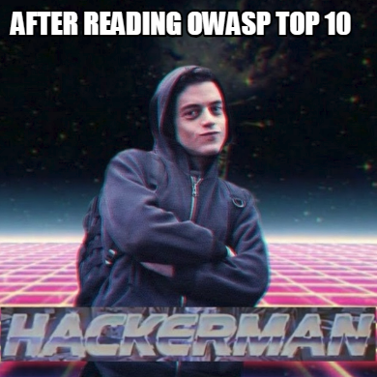
Prize
Top rank gets mad rep yo
jk… everyone's a winner if you’ve learned a single thing from these challenges
Challenge coins
no, you can’t pay for coffee with this
Gift cards
okay. yes, you can pay for coffee with this
Also, highest overall scoring student will have an opportunity to intern at Grimm (tentative)
Notes:
Next is getting started

Slide 5
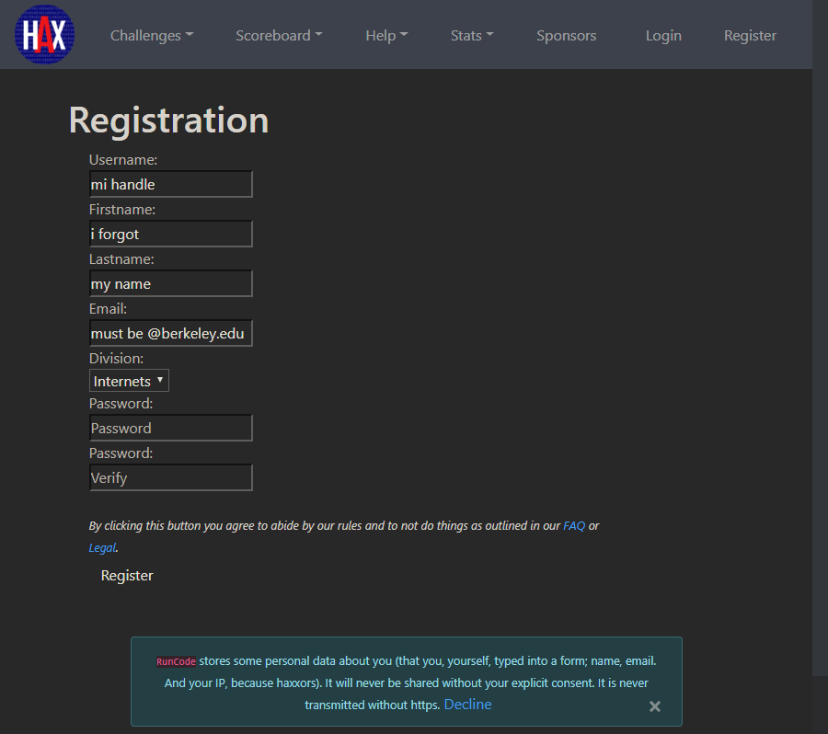
Getting Started
Go to scoreboard.hax.works/quick_reg
Register with berkeley.edu email
Hack away at challenges at scoreboard.hax.works/challenges
Notes:
Next is example challenge

Slide 6
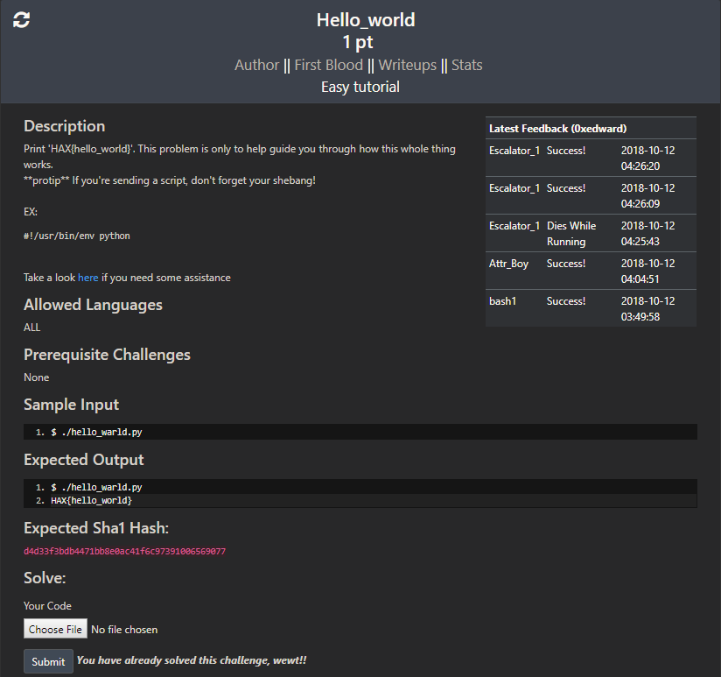
Example of a Challenge
Notes:
Next is resources

Slide 7
Resources
I compiled a list of useful blog posts and tools at 0xedward.com/awesome-infosec (shameless plug)
Shoot me a message on Slack (@0xedward) if you:
Want see a talk to go over any topic on the list, such as unix basics
Got a question about a challenge you are working on
Feel like you are missing any resources that would be helpful in your learning
Jaime (super talented contact at Grimm) is willing to work with anyone through a challenge over email and possibly over the phone
Notes:
Next is opportunity to be a hero

Slide 8

Opportunity to be a hero!
Challenges are created by college security clubs participating in the program
UC Berkeley and RPI was assigned Reverse Engineering and Binary Exploitation
Anyone willing to help write challenges for RE/BinEx? Message me on slack!
Notes:
Next is contact

Slide 9
Contact Info
Feel free to contact me (@0xedward) on Slack or Twitter with any other questions or if you want to work together on HAX
Jaime Geiger
Notes:
Next is closing challenge slide

Slide 10
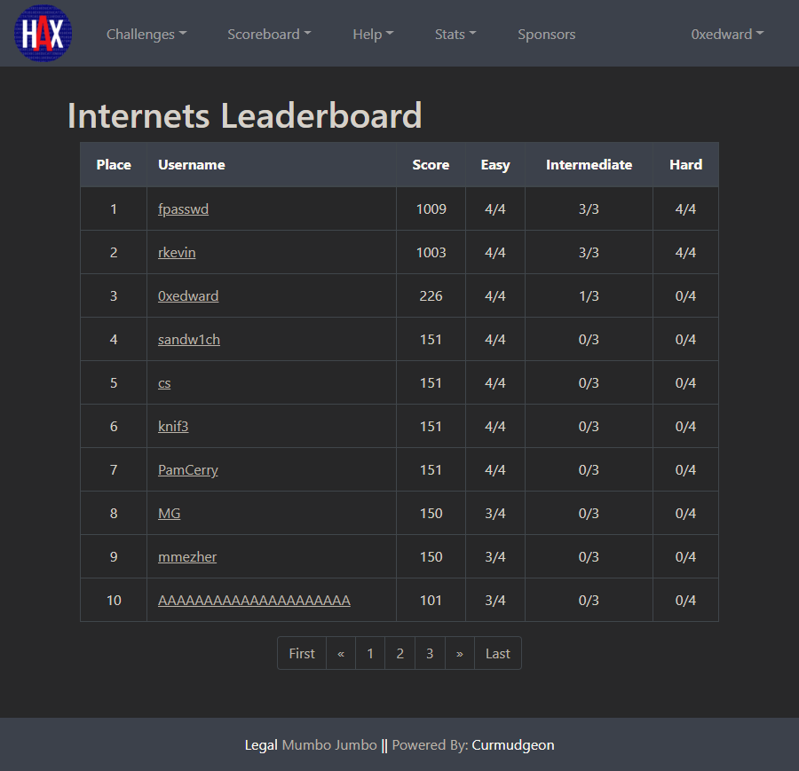
Another easy challenge:
Get on HAX and beat my ranking!
Notes:
Ayy lmao

